Slide 1
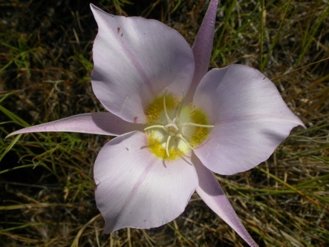
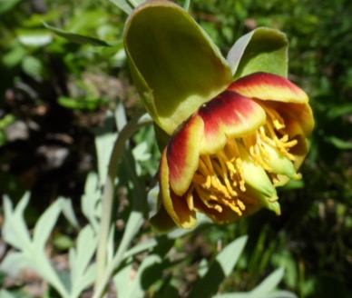
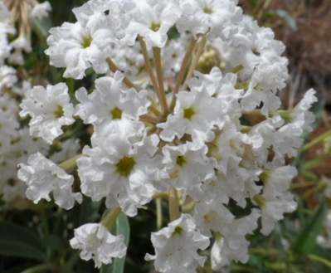
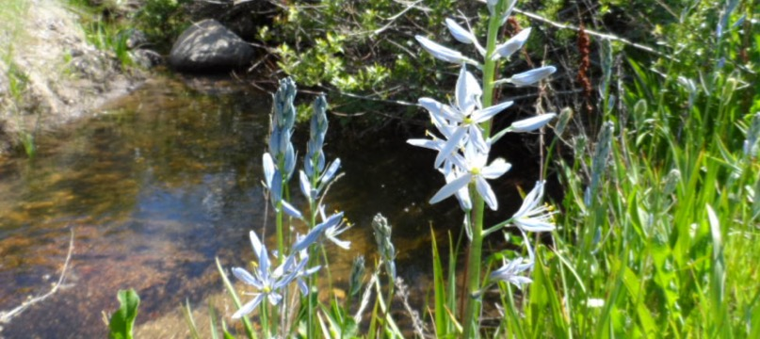
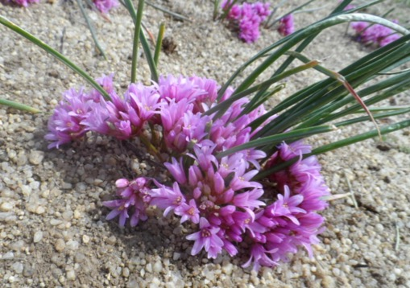
Treasures of the Boise Front Barbara Ertter

Slide 2
Military Reserve, May 2000

Slide 3
Boise Front 101
Geological underpinning
uplifted SW edge of granitic Idaho batholith
SE extent of Columbia Basalt flows (some outlying vents)
NE edge of pre-Pleistocene Lake Idaho sediments, remnant terraces deeply eroded by glacial meltwaters from batholith
Biogeographic transition zone between Pacific Northwest, Rocky Mountains, and Intermountain Desert

Slide 4
Lake Idaho (9—2 million years ago)
Signage for Hulls Gulch National Recreation Trail, BLM

Slide 5
Lake Idaho Sediments exposed in old sand mine

Slide 6
Tilted and eroded Lake Idaho terraces in Boise Foothills

Slide 7
Importance of Complex Geology and Topography
Creates many different habitat types
Each habitat type supports a different suite of species
Some habitat types increasingly rare, especially wetlands or otherwise favored for competing uses (development, grazing)
Different habitat types require different management (no “one size fits all”)

Slide 8
Habitat Diversity Increases Biodiversity

Slide 9
North-Facing vs. South-Facing Slopes

Slide 10
South exposure
Mulford’s milkvetch
Astragalus mulfordiae)
Aase’s onion (Allium aaseae)

Slide 11
North exposure
mosses & lichens covering soil
Good quality sagebrush steppe with bunchgrass, shrubs, and wildflowers
sagebrush sheltering miner’s-lettuce

Slide 12
Flowing mud during freeze-thaw cycles on fine soil of north-facing slopes

Slide 13
Plateaus
Dwarf pussytoes
(Antennaria dimorpha)
Shaggy fleabane (Erigeron pumilus)

Slide 14
Brushy Streams
Syringa or Mock-orange
(Philadephus lewisii)
Black hawthorn (Crataegus douglasii)

Slide 15
Native vs. Non-native Roses
Interior Rose NATIVE
(Rosa woodsii ssp. ultramontana)
example of NON-NATIVE rose

Slide 16
Western Poison-ivy (Toxicodendron rydbergii/Rhus radicans)

Slide 17
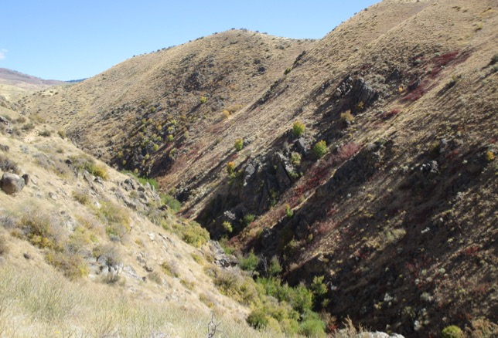
Dry Creek and Redband Trout

Slide 18
Disproportional impact of grazing on creekside habitats

Slide 19
Relictual Spring-fed Wetlands
Hidden Springs, June 2018
Council Springs, June 2018

Slide 20
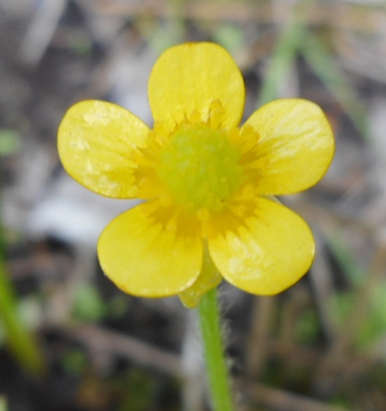
Slender cinquefoil (Potentilla gracilis)
Yellow avens (Geum aleppicum)
Oregon checkerbloom
(Sidalcea oregana)
Macoun’s buttercup (Ranunculus macounii)

Slide 21
Remnant Hot-spring Wetlands
Remnant hot-spring habitat at base of Castle Rock Reserve
(major over-wintering area for regional tribes, now geothermal source)

Slide 22
Alkali clay scald/playa
Gardner’s saltbrush
(Atriplex gardneri)

Slide 23
Prickly-pear cactus (Opuntia) at Castle Rock; native or planted?

Slide 24
Outcrops of Unusual Geology Add Habitat Diversity

Slide 25
Small-leaf bricklebrush (Brickellia microphylla) at Castle Rock Preserve

Slide 26
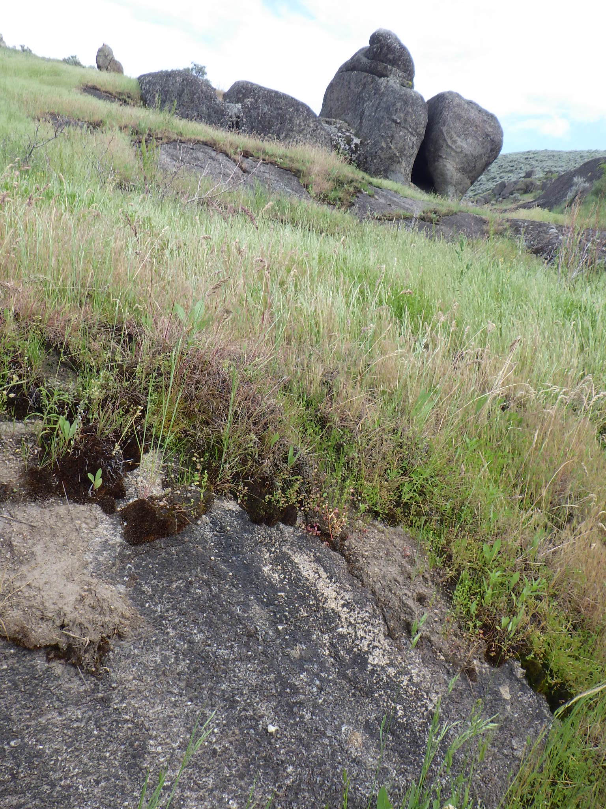
Seepage on granite outcrops, Sweet Connie Trail
Field Monkeyflower (Erythranthe arvensis,
previously in Mimulus guttatus)
White-tip clover (Trifolium variegatum)

Slide 27
Seasonal and Altitudinal Diversity

Slide 28
Easy-to-Find Early Spring Flowers
Woolly-pod milkvetch (Astragalus pushii)
Sagebrush buttercup (Ranunculus glaberrimus)
Sagebrush phlox (Phlox aculeata)

Slide 29
Harder-to-Find Spring Flowers
Indian-potato (Orogenia linearifolia)
Yellow fritillary
(Fritillaria pudica)
Small bluebells (Mertensia longiflora)

Slide 30
Look-alike Lithophragma
Smallflower woodlandstar
Lithophragma parviflorum
Bulbous woodland-star
Lithophragma glabrum

Slide 31
Best hike for rare plants in spring: Hillside to Hollow
Cusick’s primrose (Primula cusickiana)
Aase’s onion (Allium aaseae)

Slide 32
Locally rare plants in Polecat Gulch
Idaho (Idahoa scapigera)
Hairy wild-cabbage (Caulanthus pilosus)

Slide 33
Summer flowers, showy . . .
Sagebrush segolily (Calochortus macrocarpus
Wild-hyacinth
Triteleia grandiflora (Brodiaea douglasii)
Cushion buckwheat
Eriogonum ovalifolium

Slide 34
. . . and otherwise
Blepharipappus scaber
Threadleaf Phacelia (Phacelia linearis) and
Whitestem blazingstar (Mentzelia albicaulis)
Bastard toadflax
Comandra umbellata

Slide 35
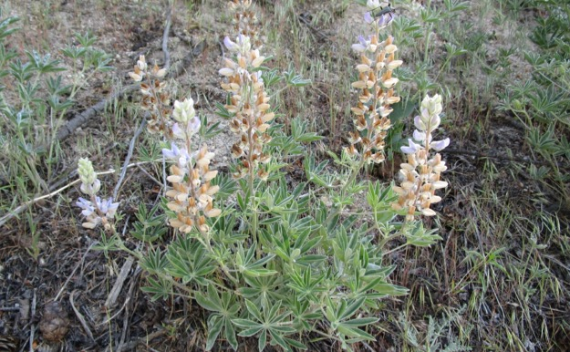
Know your Lupines!
Silvery lupine (Lupinus argenteus)
Longspur (“Polychrome”) lupine
Lupinus arbustus (L. laxiflorus)
Silky lupine (Lupinus sericeus)

Slide 36
Longspur or Polychrome lupine (bottom) mostly blooms earlier and has more multi-colored flowers than does Silvery lupine (top).

Slide 37
And how about all those those “dandelions”?
© 2008 Keir Morse
Hawkweed (Crepis spp.)
Sagebrush false-dandelion
Nothocalais (Microseris) troximoides
Large-flowered mountain-dandelion
(Agoseris grandiflora)

Slide 38
“Ringers” in the Boise Front
Cliffrose (Purshia [Cowania] stansburiana) above Hulls Gulch

Slide 39
Mojave ceanothus (Ceanothus vestitus) on Cobb Trail
Notes:
Earliest plantings in 1930’s by Rocky Mountain Research Station, USDA Forest Service, for erosion control
Research plantings in 60s & 70s to provide shrubs for deer winter range, little concern for origin beyond Great Basin
Terraces bulldozed and planted after 1959 fire “When the Pot Boiled Over”
Ongoing plantings (mostly bitterbrush) by F&G

Slide 40
Bitterbrush planted in parallel rows

Slide 41
Special Sites to the East and West

Slide 42
Oregon Trail & Lydle Gulch
Oregon Trail
trailhead
E Plexi Ct
access
Lydle GulchTrailhead
Bonneville Point Trailhead
Notes:
Underappreciate; high priority!

Slide 43
Basalt Rim south of Boise River
Notes:
Stunning views

Slide 44
Cut-leaf balsamroot(Balsamorhiza hispidula)
Western mugwort (Artemisia ludoviciana)
differs from typical local variety
Bighead clover (Trifolium macrocephalum)
Notes:
Whole new suite of flowers, on basaltic substrate (edge of Snake River Plains)

Slide 45
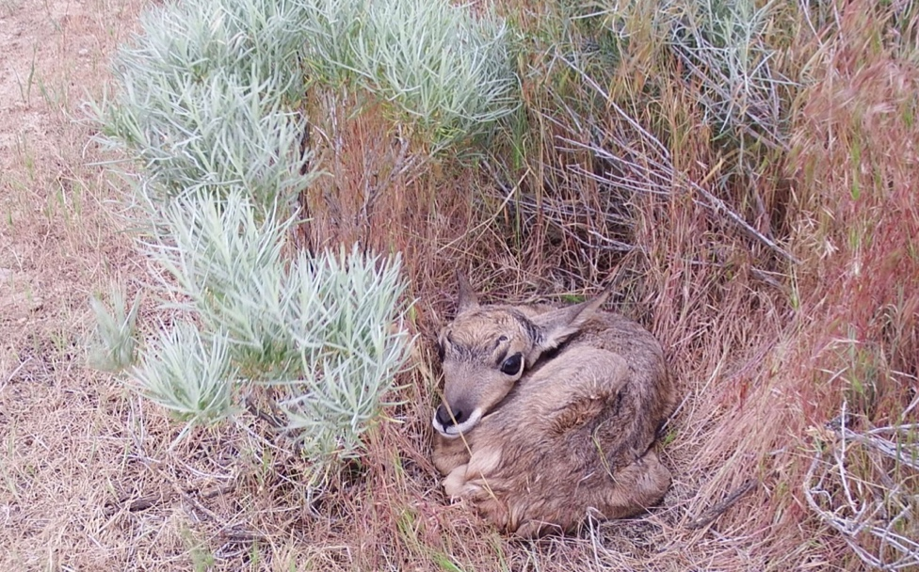
Oregon Trail Views
Antelope fawn

Slide 46
Oregon Trail “sacrifice zone”?
Notes:
Currently becoming sacrifice zone for “mudding”

Slide 47
Lydle Gulch
Foote Park
Oregon Trail
trailhead
E Plexi Ct
access
Lydle GulchTrailhead
Bonneville Point Trailhead
Notes:
Focus on Foote Park

Slide 48
Foote Park at mouth of Lydle Gulch
Notes:
Arthur and Mary Hallock Foote
True story on which Stegner’s “Angle of Repose” is based (or plagiarized)
Arthur conceived New York Canal system that irrigated the Treasure Valley (but failed to profit from it)
Family supported by Western-based novels and short stories written for Eastern audiences by Mary
“Canyon House” (in Stegner) just below Lucky Peak Dam, ruins now part of park run by Army Corps of Engineers

Slide 49
Scutellaria footeana in Lydle Gulch (now included in dwarf skullcap, Scutellaria nana)
"This was found at about 3,500 ft near Black Cañon, Boise River, June 18th. I have named the plant in honor of Mrs. Mary Hallock Foote, who planned, and accompanied me upon the pleasant expedition which led to its discovery."
-- Isabelle Mulford, 1894

Slide 50
Excerpt from “The Lamb That Couldn’t Keep Up” Mary Hallock Foote, 1889
“The band [of 8,000 sheep] slept upon the hills that night; the next morning they crossed [Lydle] gulch above the camp, and drank up by the way all the water of the little stream. Not another drop was seen for days . . . Those eastern hills in spring had been covered with wild flowers,---the moss pink, lupines both white and blue, wild phlox, the small yellow crocus [Fritillaria pudica], beds of tiny sweet-scented wild pansies, the camas flower, and a tall-stemmed, pale lilac lily [Calochortus macrocarpus],---the queen of the hill garden. But when spring came again, the old pathways were like an ash heap. The beautiful hill garden was a desert.”

Slide 51
Beckwith’s Violet (Viola beckwithii)
Bolander’s yampah (Perideridia bolanderi)
Hare’s foot milkvetch
Astragalus purshii var. lagopinus
Notes:
Unique plants for this part of the Boise Front

Slide 52
Trails north of Hidden Springs
Notes:
Trailhead (note spring-fed meadow)
Trail crosses subdivision to Currant Creek

Slide 53
Tolmie’s onion (Allium tolmiei) or?
Freckled milkvetch (Astragalus lentiginosus)

Slide 54
Camas (Camassia quamash) along Currant Creek

Slide 55
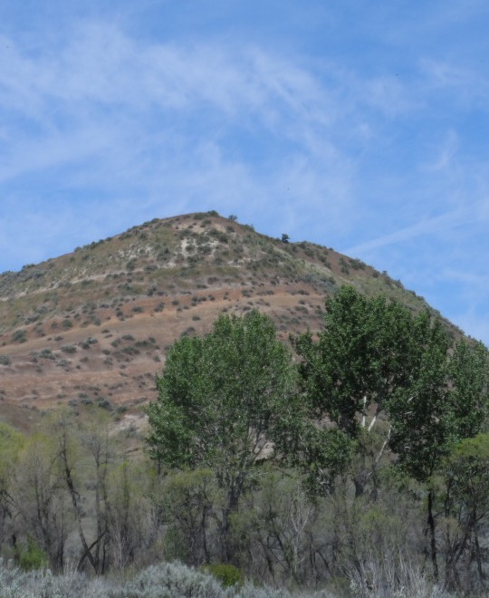
Trails of Avimor
Canary Violet (Viola praemorsa)
Narrowleaf Skulllcap (Scutellaria angustifolia)
Notes:
Just barely starting to explore Avimor trails
already finding plants not encountered elsewhere in Boise Front

Slide 56
Pallid Milkweed (Asclepias cryptoceras)

Slide 57
Stack Rock Road
Notes:
Biggest surprise

Slide 58
Stack Rock Road north of
Shadow Hills Golf Course

Slide 59
Purple Sage (Salvia dorrii)

Slide 60
Moving up in elevation

Slide 61
Low-diversity Mid-elevation Pastureland
March 2015
Notes:
Upper edge of sediments
Long history of sheep and cattle grazing
Planted with non-native grasses following 1959 (and other) fires; also pasture improvement on private lands
Now very low biodiversity

Slide 62
Wind-swept Ridge
Carpet phlox (Phlox hoodii)
Scabland fleabane (Erigeron bloomeri)
Notes:
Above Lake Idaho sediments

Slide 63
Best Mid-elevation
Wildflower Display
Watchman Trail

Slide 64
Boise Milkvetch (Astragalus adanus)
(Not to be confused with the more common Hermit milkvetch (Astragalus eremiticus), which has somewhat yellower flowers and stalked pods)

Slide 65
Silverleaf phacelia (Phacelia hastata) with parasitic clustered broomrape (Orobanche fasciculata)

Slide 66
Upper Hulls Gulch Interpretive Loop
White sego-lily (Calochortus eurycarpus)
Dogbane (Apocynum androsaemifolium)

Slide 67
Upper Dry Creek Trails
Notes:
Entering forest of douglas-fir and ponderosa pine on Idaho Batholith, approaching Boise Ridge

Slide 68
Pretty Penstemon
Payette Penstemon
(Penstemon payettensis)
Wilcox’s Penstemon (Penstemon wilcoxii)

Slide 69
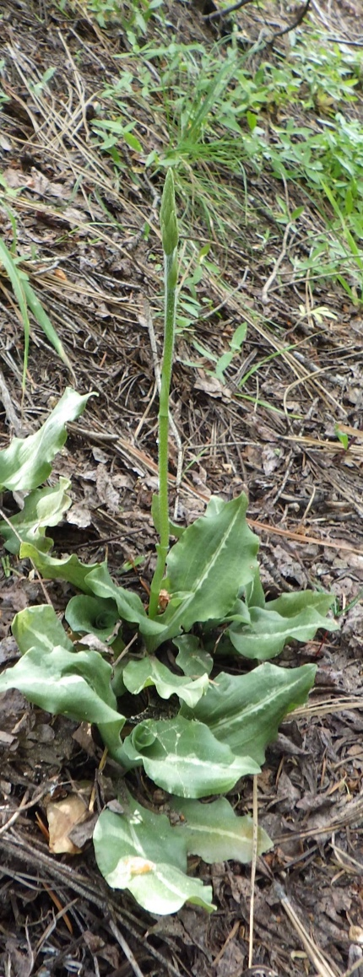
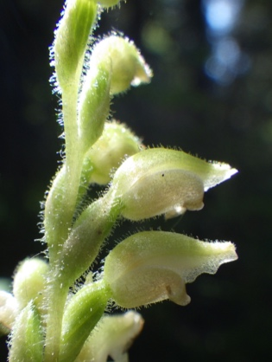
Orchids and More!
Rattlesnake-plantain
(Goodyera oblongifolia)
Alaska rein-orchid
(Plantanthera unalascensis)
Pinedrops
(Pterospora andromedea)

Slide 70
Trails of Bogus Basin/Shafer Butte

Slide 71
Coville’s paintbrush
Sticky geranium
Kitten-tails
Cusick’s fumewort

Slide 72
More’s Mountain
Brown’s Peony (Paeonia brownii)

Slide 73
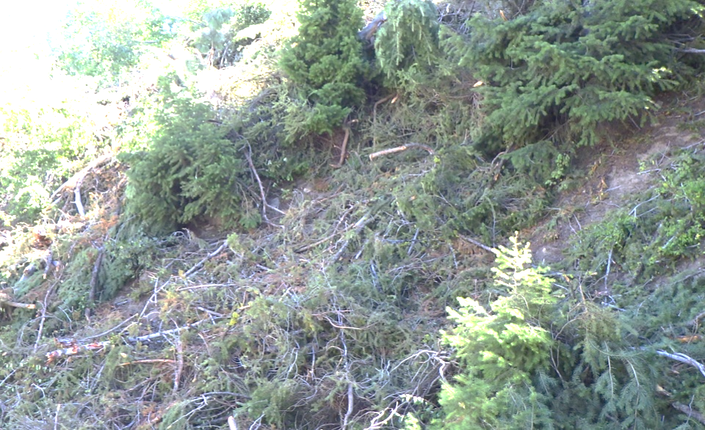
Dwarf-mistletoe (Arceuthobium douglasii) on Douglas-fir
Dead trees at Bogus Basin
Douglas-fir dwarf mistletoe
Thinning activity, 2019

Slide 74
Autumn Hikes for Fall Colors . . .

Slide 75
. . . and Late Bloomers.
Hoary aster (Dieteria/Machaeranthera)
Yampah (Perideridia montana)
Broom buckwheat (Eriogonum vimineum)
Goldenrod (Solidago)

Slide 76
Rubber rabbitbrush (Ericameria nauseosa) in the Boise Front
var. oreophila
var. hololeuca

Slide 77
Big sagebrush (Artemisia tridentata) in the Boise Front
ssp. tridentata
ssp. vaseyana

Slide 78
Special Plants of the Boise Front
Every plant species grows in only a certain part of the world; some plants have extremely limited distributions.
The ancient shoreline of Lake Idaho on the edge of the Idaho Batholith created unique habitats, which are now home to several very rare plants.
New plants are still being described in the Boise Front; most of these had previously been shoe-horned into other species but are now understood to be distinct.

Slide 79
Aase’s onion (Allium aaseae)
Named for Helen Aase
Grows only from Boise to Emmett; threatened by development

Slide 80
Mulford’s milkvetch (Astragalus mulfordiae)
Named for Isabelle Mulford
Grows only from Boise to Vale; threatened by development

Slide 81
Slickspot peppergrass (Lepidium papilliferum)
“Slickspots” in western Snake River Plains and adjacent foothills;
no longer present at most historical locations in the Boise Front

Slide 82
Sacajawea Bitter-root (Lewisia sacajaweana)
Described in 2005 (previously included in Lewisia kelloggii of California)
Endemic to central Idaho; threatened by open-pit gold mining.

Slide 83
Hare’s-foot Milkvetch (Astragalus purshii var. lagopinus)
Var. lagopinus mostly central Oregon,
only recently found in Idaho
Var. glareosus common in foothills;
not tightly tufted, flowers larger

Slide 84
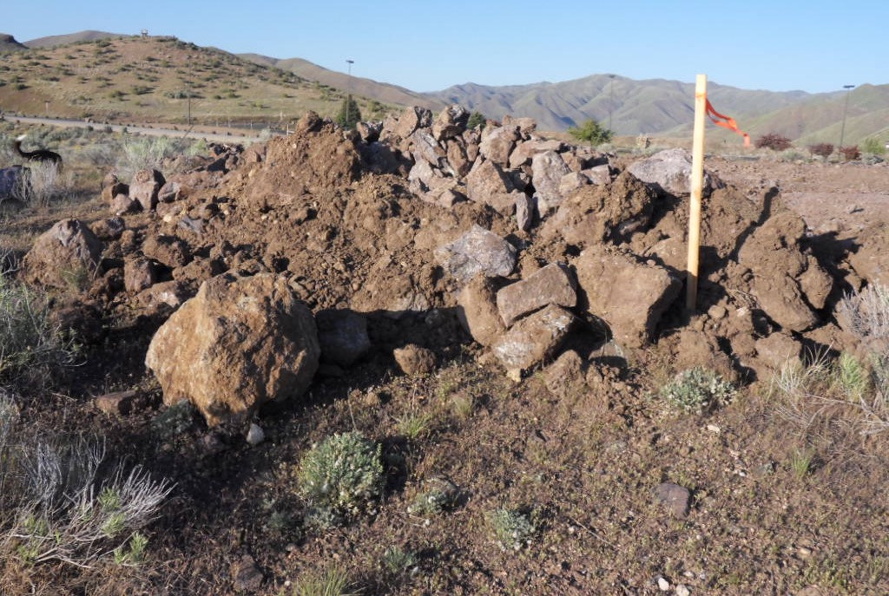
Remaining plants of hare’s-foot milkvetch (foreground) at edge of expanded
parking area for Lydle Gulch disc-golf course.
Notes:
Next year’s visit; parking lot for disk golf course
Note plants in foreground

Slide 85
Boise Sand-Verbena (Abronia mellifera var. pahoveorum)
Described as a new variety in 2016; grows only
from Boise to Emmett; threatened by development

Slide 86
Is White-lined sphinx moth (Hyles lineata) the primary pollinator of the Boise Sand-verbena, and is it in decline?
photo by Steve Creek
Notes:
Evening blooming, long narrow tube, light fragrance => Probable pollinator; also on decline??? (unknown)
Onagraceae (including Epilobium brachycarpum) as primary larval host, probably Abronia as well
Evening-primrose often in same habitat with Abronia, may collectively help attract pollinators

Slide 87
Andrus’s Bicuitroot (Lomatium andrusianum)
Described as new species in 2018, previously included in Lomatium triternatum
Grows in clay soils on north edge of Snake River Plains.

Slide 88
Damage to population of Andrus’s biscuitroot caused by road construction for new development; note long exposed roots in photo on right

Slide 89
At an undisclosed location . . .
Pediocactus simpsonii, nigrispina, or ???

Slide 90
Some local onions that “haven’t read the book”
Allium tolmiei, A. lemmonii, or ?
Not quite either Allium aaseae or Allium simillimum, but somewhere in between

Slide 91
Possible undescribed variety of western mugwort (Artemisia ludoviciana)
Unusual form on basalt cliff
Common variety occurring locally

Slide 92
Boise Front “Treasures” Under Siege
Bulldozing for housing developments, roads, and other construction.
Displacement by invasive non-native species, in particular annual grasses.
Intentional habitat alteration for grazing, fire control, and other purposes.
Cumulative impact of uninformed or uncaring recreational and other activities.
All of these result in cumulative habitat loss, and each contributes to the others.

Slide 93
Intact shrub-steppe with abundant wildflower diversity & wildlife habitat
This used to be the most common habitat in the Boise Foothills, now increasingly rare.

Slide 94
Open areas between shrubs and bunchgrasses provide critical habitat and limit fire spread

Slide 95
Invasive non-natives fill open areas, choking out natives and spreading fires
Invasive bachelor-buttons and
cheatgrass filling in between shrubs
Feral rye displacing everything else

Slide 96
After repeated episodes of disturbance, invasive non-natives, and fire, this . . .

Slide 97
. . . becomes this.

Slide 98
Reversal is difficult, expensive, and seldom completely successful.
easy!
very
hard!
Mosaic of high diversity of natives
Monoculture of non-natives

Slide 99
Invasive non-native annual grasses, such as feral rye (foreground), are a major contributing factor to large fires, such as the one on Tablerock (background)

Slide 100
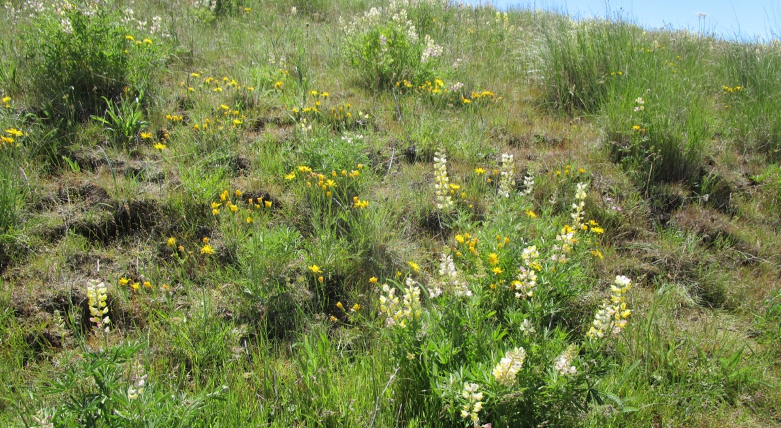
What you can do!
Avoid disturbing the remaining “best of what’s left” habitats.

Slide 101
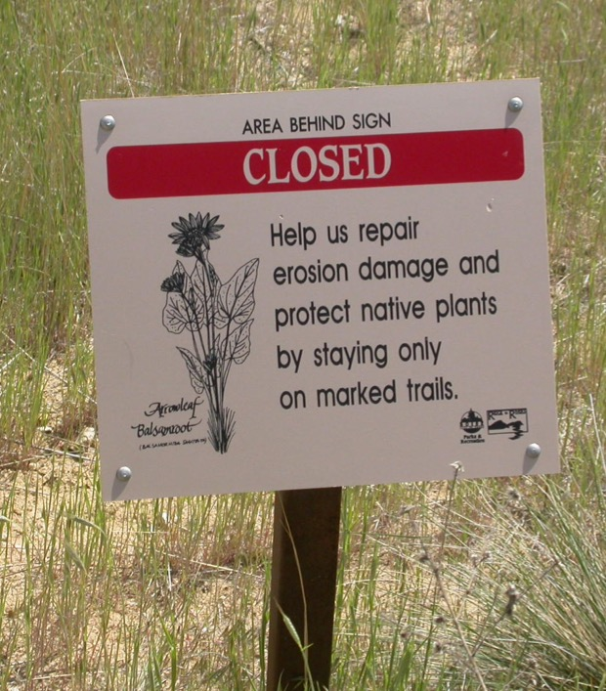
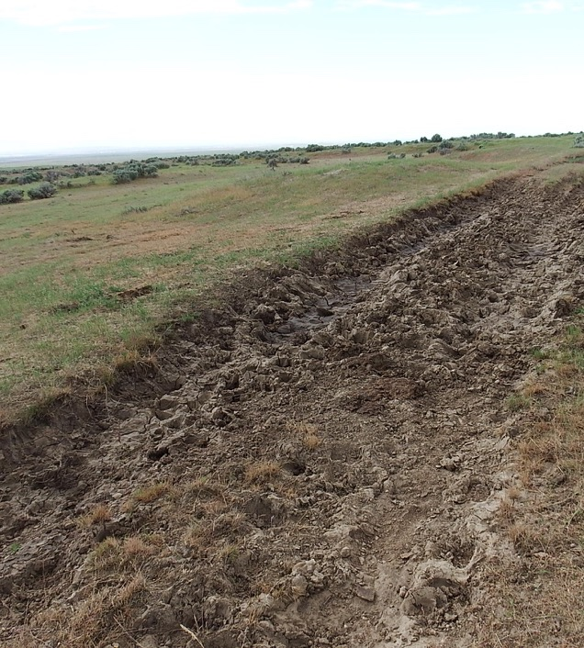
What you can do!
Be responsible in your recreation decisions.

Slide 102
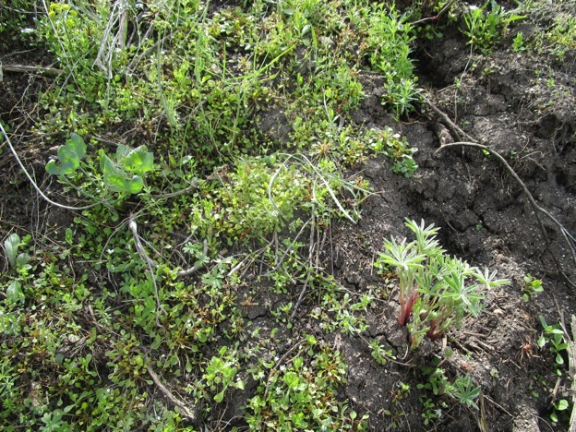
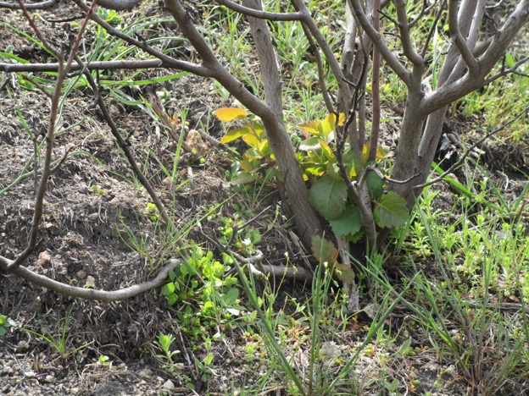
What you can do!
Pay attention to native species diversity when undertaking fire control measures, post-fire treatments, and other habitat modifications (note: one size does NOT fit all!)
Natural recovery following Tablerock fire

Slide 103
What you can do!
Practice responsible gardening at wildland interface.
Myrtle spurge spreading downhill
Hardy pampas grass taking over slope

Slide 104
What you can do!
Become a ”Weed Warrior”, either as an individual or in group activities.

Slide 105
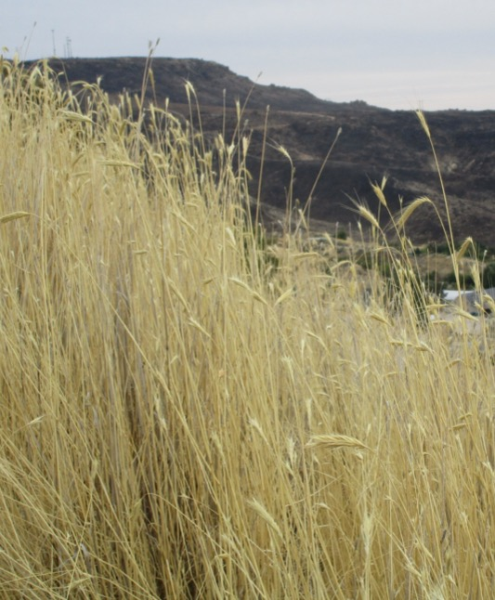
What you can do!
Creative uses of invasive non-natives?
Feral rye
Wry not?

Slide 106
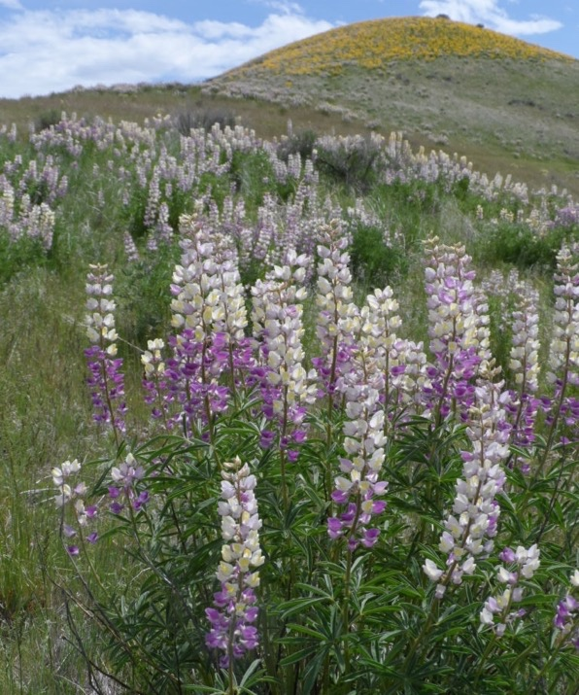
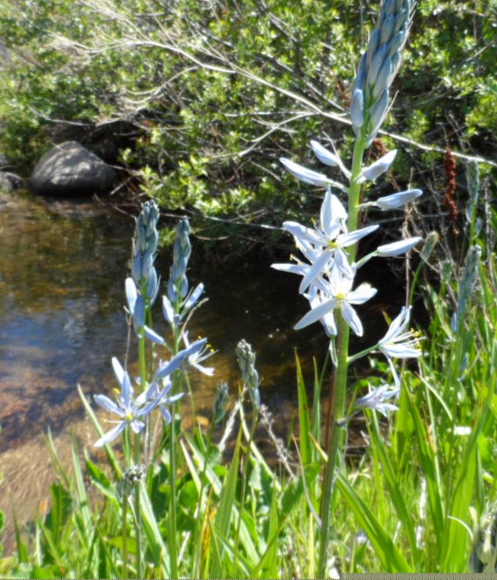
What you can do!
Appreciate and enjoy our unique native wildflowers!

Slide 107
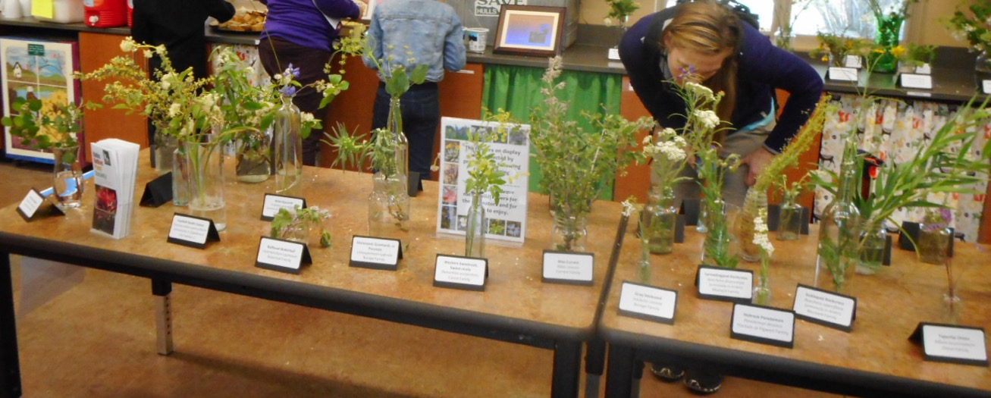
Idaho Native Plant Society’s 3rd Annual Wildflower+ Show Mother’s Day, Sunday, May 10 11 am to 4 pm, Foothills Learning Center
Where the Flowers Come to YOU!

Slide 108
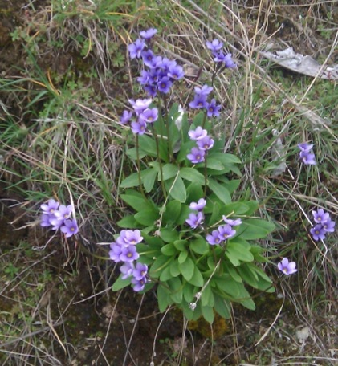
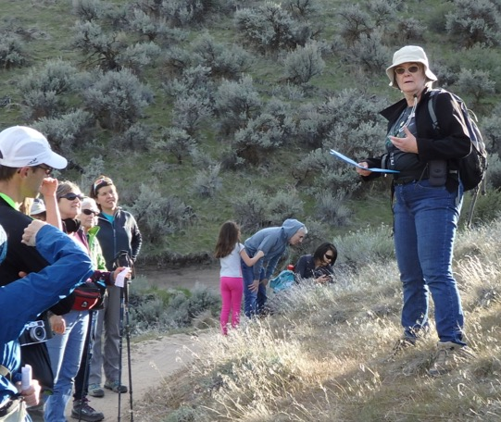
"Treasures of the Boise Front" Wildflower Walk Series, Spring-Summer 2020
An introduction to a selection of public trails with the best diversity of native wildflowers throughout the Boise Front. *Pre-registration is required. These walks are free but have a maximum of 20 participants each. To register, please visit cityofboise.org/parks or call 208-608-7680.

